Slide 1
Data Management CT051-3-M
Topic 5 – Exploratory Data Analysis

Slide 2
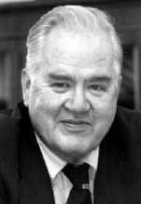
Exploratory Data Analysis
John Tukey (1970s)
data
two components:
smooth + rough
patterned behaviour + random variation
resistant measures/displays
little influenced by changes in a small proportion of the total number of cases
resistant to the effects of outliers
emphasizes smooth over rough components
concepts apply to statistics and to graphical methods

Slide 3
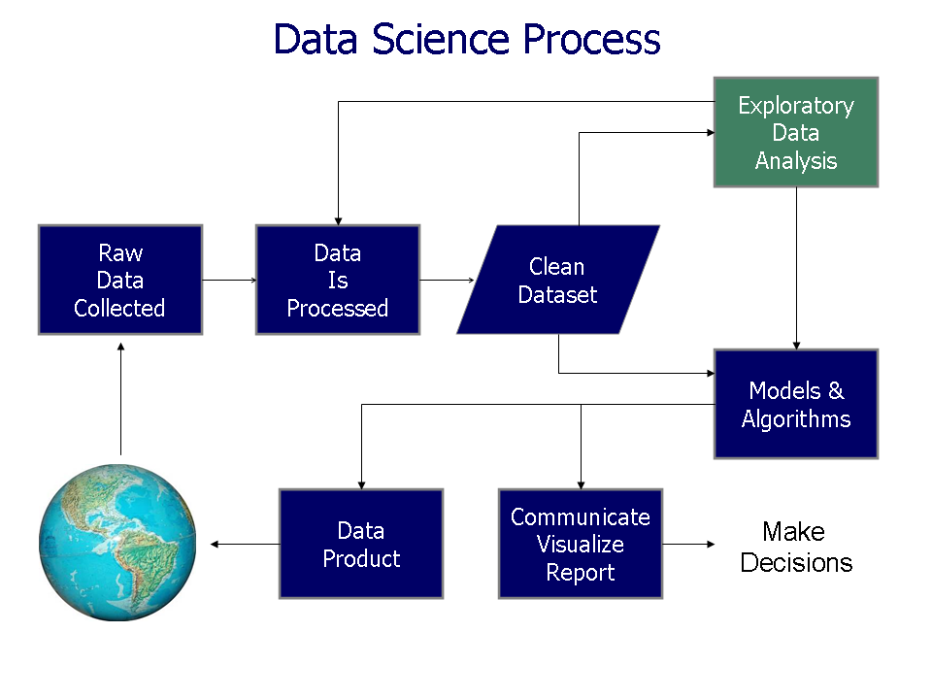
Exploratory Data Analysis

Slide 4
15,000 2
20,000 5
30,000 10
35,000 1
40,000 20
50,000 10
6 category
4 bins
15k -20 k = rank 1(7)
21k – 30k = rank 2 (10)
31-40 = rank 3 (21)
41-50 = rank 4 (30)
4 bins

Slide 5
EDA and Visualization
Exploratory Data Analysis (EDA) and Visualization are very important steps in any analysis task.
get to know your data!
distributions (symmetric, normal, skewed)
data quality problems
outliers
correlations and inter-relationships
subsets of interest
suggest functional relationships
Sometimes EDA or viz might be the goal!

Slide 6
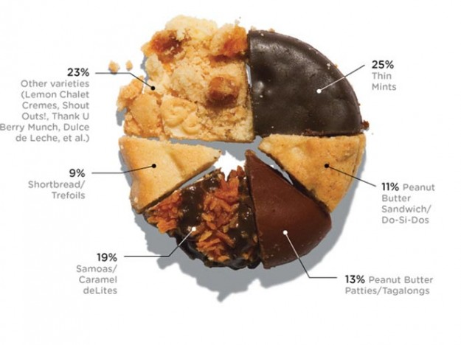
Data Visualization – cake bakery

Slide 7
Exploring Data

Slide 8
Categorical data
Frequency
Percentage (Row, Column or Total)
Continuous data: Measure of location
Descriptive statistics
Mean
Median
e
Continuous data: Measure of variation
Standard deviation
Range (Min, Max)
Inter-quartile range (LQ, UQ)
Exploring data
Categorical data
Bar chart
Clustered bar charts (two categorical variables)
Bar charts with error bars
Continuous data
Graphical illustrations
Histogram (can be plotted against a categorical variable)
Box & Whisker plot (can be plotted against a categorical variable)
Dot plot (can be plotted against a categorical variable)
Scatter plot (two continuous variables)
Notes:
Categorical – Mode
Ordinal – Median
Quantitative (Ratio/Interval) – Mean, NOTE: You can use median to detect outlier in data.
Variance:
STEP1: Calculate the mean
STEP2: For each number in the distribution, subtract the mean and square the number.
STEP3: Calculate the average of the squared number.
Standard deviation: Square root of the variance

Slide 9
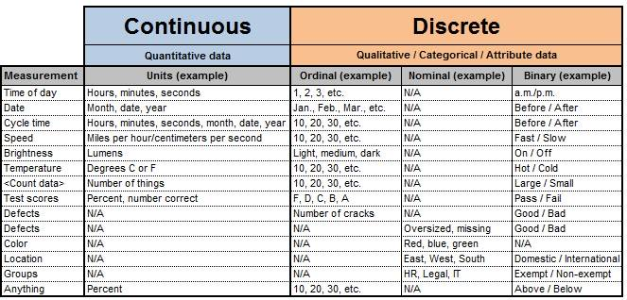

Slide 10
Exercise
1. Calculate the Mean, Median, Variance and Standard deviation.
Five students enrolled for Data Management module. The students score can range from 0 to 100.
The following are the students score:
83, 94, 30, 63, 66
Notes:
STEP 1: Calculate the variance – 473.87
STEP 2: Standard deviation – 21.77

Slide 11
Exercise
2. For the given two vector, identify the Mean, Median, Mode and Standard Deviation
A = {2, 2, 4, 4, 2, 5, 6}
B = {2, 2, 4, 400, 4, 2, 5, 6}

Slide 12
InterQuartile Range (IQR)
When a dataset has outliers or extreme values, we summarize a typical value using the median as opposed to the mean.
Variability is often summarized by a statistic called the interquartile range.
Interquartile Range = Q₃-Q₁
Notes:
http://sphweb.bumc.bu.edu/otlt/mph-modules/bs/bs704_summarizingdata/bs704_summarizingdata7.html

Slide 13
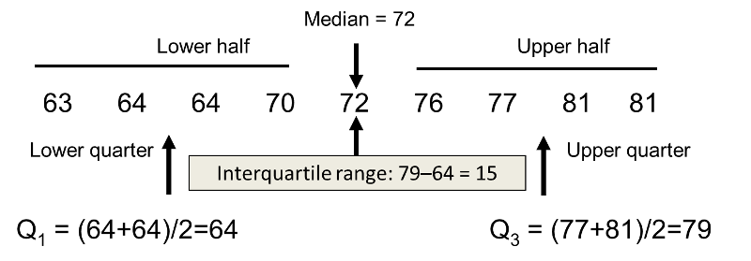
Interquartile Range with an Odd Sample Size

Slide 14
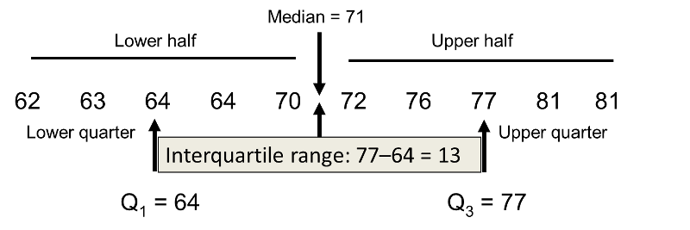
Interquartile Range with Even Sample Size

Slide 15
Exercise
3. Apply the Interquartile Ranges (IQR) to determine the outliers that exist in the above distribution.
Height measures of the graduate students are reported as follows:
130 | 132 | 138 | 136 | 131 | 153 | 131 | 133 | 129 | 133 | 110 | 132 | 129 | 134 | 135
132 | 135 | 134 | 133 | 132 | 130 | 131 | 134 | 135 | 135 | 134 | 136 | 133 | 133 | 130
Notes:
FINDING LOW IQR = <=126
FINDING HIGH IQR = >=138
FINDING TWO OUTLIERS = 110,153
https://www.shmoop.com/basic-statistics-probability/box-whisker-plots.html
In order to be an outlier, the data value must be:
larger than Q3 by at least 1.5 times the interquartile range (IQR), or
smaller than Q1 by at least 1.5 times the IQR.

Slide 16
Categorical Data
Frequency Distribution
Frequency Table

Slide 17
Categorical Data
Organize qualitative data into a frequency table.
Present a frequency table as a bar chart or a pie chart.
Organize quantitative data into a frequency distribution.
Present a frequency distribution for quantitative data using histograms, frequency polygons, and cumulative frequency polygons.

Slide 18
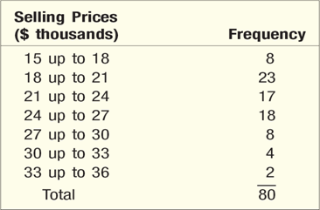
Frequency Distribution
A Frequency distribution is a grouping of data into mutually exclusive categories showing the number of observations in each class. The table shows a frequency distribution for a set of quantitative data.
18

Slide 19
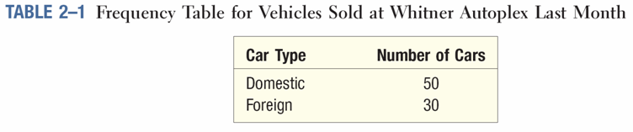
Frequency Table
19

Slide 20
Descriptive Statistics
Continuous Data: Measure of Location
Mean
Median
Mode

Slide 21
Central value
Give information concerning the average or typical score of a number of scores
mean
median

Slide 22
Central value: The Mean
The Mean is a measure of central value
What most people mean by “average”
Sum of a set of numbers divided by the number of numbers in the set

Slide 23
Central value: The Mean
Arithmetic average:
Sample Population

Slide 24
Central value: The Median
Middlemost or most central item in the set of ordered numbers; it separates the distribution into two equal halves
If odd n, middle value of sequence
if X = [1,2,4,6,9,10,12,14,17]
then 9 is the median
If even n, average of 2 middle values
if X = [1,2,4,6,9,10,11,12,14,17]
then 9.5 is the median; i.e., (9+10)/2
Median is not affected by extreme values

Slide 25
When to Use What
Mean is a great measure. But, there are time when its usage is inappropriate or impossible.
Nominal data: Mode
The distribution is bimodal: Mode
You have ordinal data: Median or mode
Are a few extreme scores: Median

Slide 26
Mean, Median, Mode
Mean
Mode
Mean
Median
Mode
Mode
Mean
Median
Median
Negatively
Skewed
Symmetric
(Not Skewed)
Positively
Skewed

Slide 27
Descriptive Statistics
Continuous Data: Measure of Variance
Standard deviation
Range
Interquartile

Slide 28
Range
The spread, or the distance, between the lowest and highest values of a variable.
To get the range for a variable, you subtract its lowest value from its highest value.
Class A--IQs of 13 Students
102 115
128 109
131 89
98 106
140 119
93 97
110
Class A Range = 140 - 89 = 51
Class B--IQs of 13 Students
127 162
131 103
96 111
80 109
93 87
120 105
109
Class B Range = 162 - 80 = 82

Slide 29
Interquartile Range
A quartile is the value that marks one of the divisions that breaks a series of values into four equal parts.
The median is a quartile and divides the cases in half.
25th percentile is a quartile that divides the first ¼ of cases from the latter ¾.
75th percentile is a quartile that divides the first ¾ of cases from the latter ¼.
The interquartile range is the distance or range between the 25th percentile and the 75th percentile. Below, what is the interquartile range?
25%
25%
25% of cases
25% of cases
0 250 500 750 1000

Slide 30
Standard Deviation
To convert variance into something of meaning, let’s create standard deviation.
The square root of the variance reveals the average deviation of the observations from the mean.
s.d. = Σ(Yi – Y-bar)²
n - 1

Slide 31
Standard Deviation
For Class A, the standard deviation is:
235.45 = 15.34
The average of persons’ deviation from the mean IQ of 110.54 is 15.34 IQ points.
Review:
1. Deviation
2. Deviation squared
3. Sum of squares
4. Variance
5. Standard deviation

Slide 32
Standard Deviation
Larger s.d. = greater amounts of variation around the mean.
For example:
19 25 31 13 25 37
Y = 25 Y = 25
s.d. = 3 s.d. = 6
s.d. = 0 only when all values are the same (only when you have a constant and not a “variable”)
If you were to “rescale” a variable, the s.d. would change by the same magnitude—if we changed units above so the mean equaled 250, the s.d. on the left would be 30, and on the right, 60
Like the mean, the s.d. will be inflated by an outlier case value.

Slide 33
Standard Deviation
Note about computational formulas:
Your book provides a useful short-cut formula for computing the variance and standard deviation.
This is intended to make hand calculations as quick as possible.
They obscure the conceptual understanding of our statistics.
SPSS and the computer are “computational formulas” now.

Slide 34
Practical Application for Understanding Variance and Standard Deviation
Even though we live in a world where we pay real dollars for goods and services (not percentages of income), most American employers issue raises based on percent of salary.
Why do supervisors think the most fair raise is a percentage raise?
Answer: 1) Because higher paid persons win the most money.
2) The easiest thing to do is raise everyone’s salary by a fixed percent.
If your budget went up by 5%, salaries can go up by 5%.
The problem is that the flat percent raise gives unequal increased rewards. . .

Slide 35
Practical Application for Understanding Variance and Standard Deviation
Acme Toilet Cleaning Services
Salary Pool: $200,000
Incomes:
President: $100K; Manager: 50K; Secretary: 40K; and Toilet Cleaner: 10K
Mean: $50K
Range: $90K
Variance: $1,050,000,000 These can be considered “measures of inequality”
Standard Deviation: $32.4K
Now, let’s apply a 5% raise.

Slide 36
Practical Application for Understanding Variance and Standard Deviation
After a 5% raise, the pool of money increases by $10K to $210,000
Incomes:
President: $105K; Manager: 52.5K; Secretary: 42K; and Toilet Cleaner: 10.5K
Mean: $52.5K – went up by 5%
Range: $94.5K – went up by 5%
Variance: $1,157,625,000 Measures of Inequality
Standard Deviation: $34K –went up by 5%
The flat percentage raise increased inequality. The top earner got 50% of the new money. The bottom earner got 5% of the new money. Measures of inequality went up by 5%.
Last year’s statistics:
Acme Toilet Cleaning Services annual payroll of $200K
Incomes:
$100K, 50K, 40K, and 10K
Mean: $50K
Range: $90K; Variance: $1,050,000,000; Standard Deviation: $32.4K

Slide 37
Practical Application for Understanding Variance and Standard Deviation
The flat percentage raise increased inequality. The top earner got 50% of the new money. The bottom earner got 5% of the new money. Inequality increased by 5%.
Since we pay for goods and services in real dollars, not in percentages, there are substantially more new things the top earners can purchase compared with the bottom earner for the rest of their employment years.
Acme Toilet Cleaning Services is giving the earners $5,000, $2,500, $2,000, and $500 more respectively each and every year forever.
What does this mean in terms of compounding raises?
Acme is essentially saying: “Each year we’ll buy you a new TV, in addition to everything else you buy, here’s what you’ll get:”

Slide 38
Practical Application for Understanding Variance and Standard Deviation
Toilet Cleaner Secretary Manager President
The gap between the rich and poor expands.
This is why some progressive organizations give a percentage raise with a flat increase for lowest wage earners. For example, 5% or $1,000, whichever is greater.

Slide 39
Visualization

Slide 40
Visualization
Categorical Data
Bar Chart

Slide 41
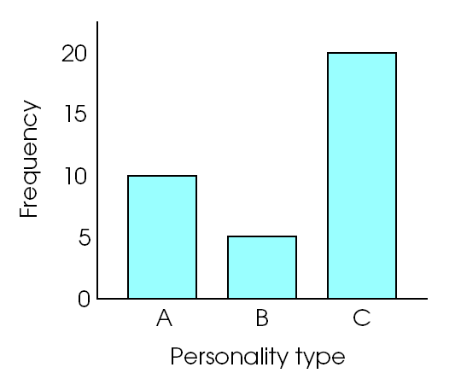
Bar Graphs
For categorical data
Like a histogram, but with gaps between bars
Useful for showing two samples side-by-side

Slide 42
Visualization
Continuous Data
Histogram
Box & Whisker Plot

Slide 43
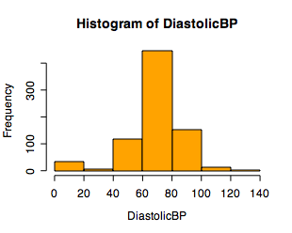
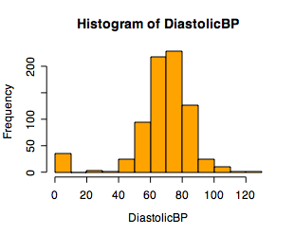
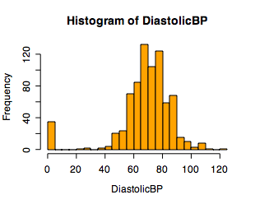
Single Variable Visualization
Histogram:
Shows center, variability, skewness, modality,
outliers, or strange patterns.
Bin width and position matter
Beware of real zeros
No gaps between bars

Slide 44
Issues with Histograms
For small data sets, histograms can be misleading.
Small changes in the data, bins, or anchor can deceive
For large data sets, histograms can be quite effective at illustrating general properties of the distribution.
Histograms effectively only work with 1 variable at a time
But ‘small multiples’ can be effective

Slide 45
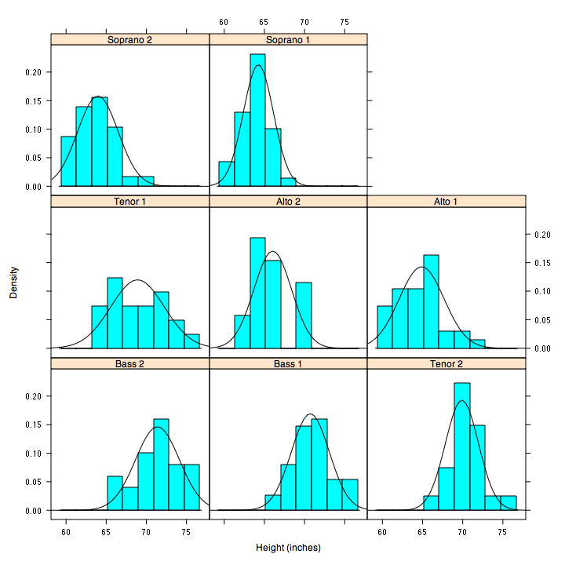
But be careful with axes and scales!

Slide 46
Box-Plots
A way to graphically portray almost all the descriptive statistics at once is the box-plot.
A box-plot shows: Upper and lower quartiles
Mean
Median
Range
Outliers (1.5 IQR)

Slide 47
Box-Plots
IQR = 27; There is no outlier.
162
123.5
M=110.5
106.5
96.5
82

Slide 48
IQV—Index of Qualitative Variation
For nominal variables
Statistic for determining the dispersion of cases across categories of a variable.
Ranges from 0 (no dispersion or variety) to 1 (maximum dispersion or variety)
1 refers to even numbers of cases in all categories, NOT that cases are distributed like population proportions
IQV is affected by the number of categories

Slide 49
IQV—Index of Qualitative Variation
To calculate:
K(100² – Σ cat.%²)
IQV = 100²(K – 1)
K=# of categories
Cat.% = percentage in each category

Slide 50
IQV—Index of Qualitative Variation
Problem: Is SJSU more diverse than UC Berkeley?
Solution: Calculate IQV for each campus to determine which is higher.
SJSU: UC Berkeley:
Percent Category Percent Category
00.6 Native American 00.6 Native American
06.1 Black 03.9 Black
39.3 Asian/PI 47.0 Asian/PI
19.5 Latino 13.0 Latino
34.5 White 35.5 White
What can we say before calculating? Which campus is more evenly distributed?
K (100² – Σ cat.%²)
IQV = 100²(K – 1)

Slide 51
IQV—Index of Qualitative Variation
Problem: Is SJSU more diverse than UC Berkeley? YES
Solution: Calculate IQV for each campus to determine which is higher.
SJSU: UC Berkeley:
Percent Category %² Percent Category %²
00.6 Native American 0.36 00.6 Native American 0.36
06.1 Black 37.21 03.9 Black 15.21
39.3 Asian/PI 1544.49 47.0 Asian/PI 2209.00
19.5 Latino 380.25 13.0 Latino 169.00
34.5 White 1190.25 35.5 White 1260.25
K = 5 Σ cat.%² = 3152.56 k = 5 Σ cat.%² = 3653.82
100² = 10000
K (100² – Σ cat.%²)
IQV = 100²(K – 1)
5(10000 – 3152.56) = 34237.2 5(10000 – 3653.82) = 31730.9
10000(5 – 1) = 40000 SJSU IQV = .856 10000(5 – 1) = 40000 UCB IQV =.793

Slide 52
Question & Answer Session
Q & A

